Slide 1

Case Records of the Massachusetts General Hospital Case 36-2021: A 22-Year-Old Man with Pain and Erythema of the Left Hand
Lisa G. Winston, M.D., Marisa L. Winkler, M.D., Ph.D., Arvin Kheterpal, M.D., and Julian A. Villalba, M.D.
N Engl J Med
Volume 385(22):2078-2086
November 25, 2021

Slide 2
Summary
A 22-year-old man was admitted with pain and erythema of the left hand.
On the day of admission, he awoke with pain and swelling of the hand that involved the second and fourth fingers.
Over several hours, the pain progressed and bullae began to form.
The patient had recently begun practicing taxidermy.
A diagnostic test was performed.

Slide 3
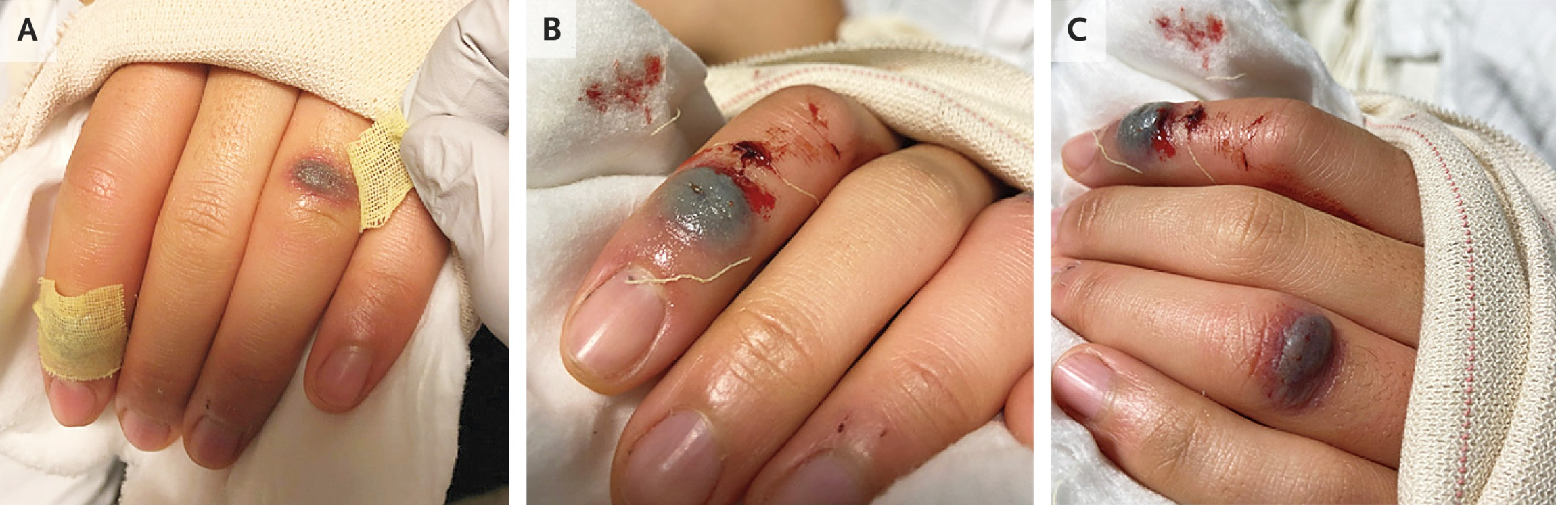
Clinical Photographs.
Winston LG et al. N Engl J Med2021;385:2078-2086
Notes:
Figure 1 Clinical Photographs. Photographs of the patient’s left hand show violaceous bullae on the proximal interphalangeal joint of the fourth digit (Panel A) and the distal interphalangeal joint of the second digit (Panel B), each measuring 7 mm by 3 mm (Panel C).

Slide 4
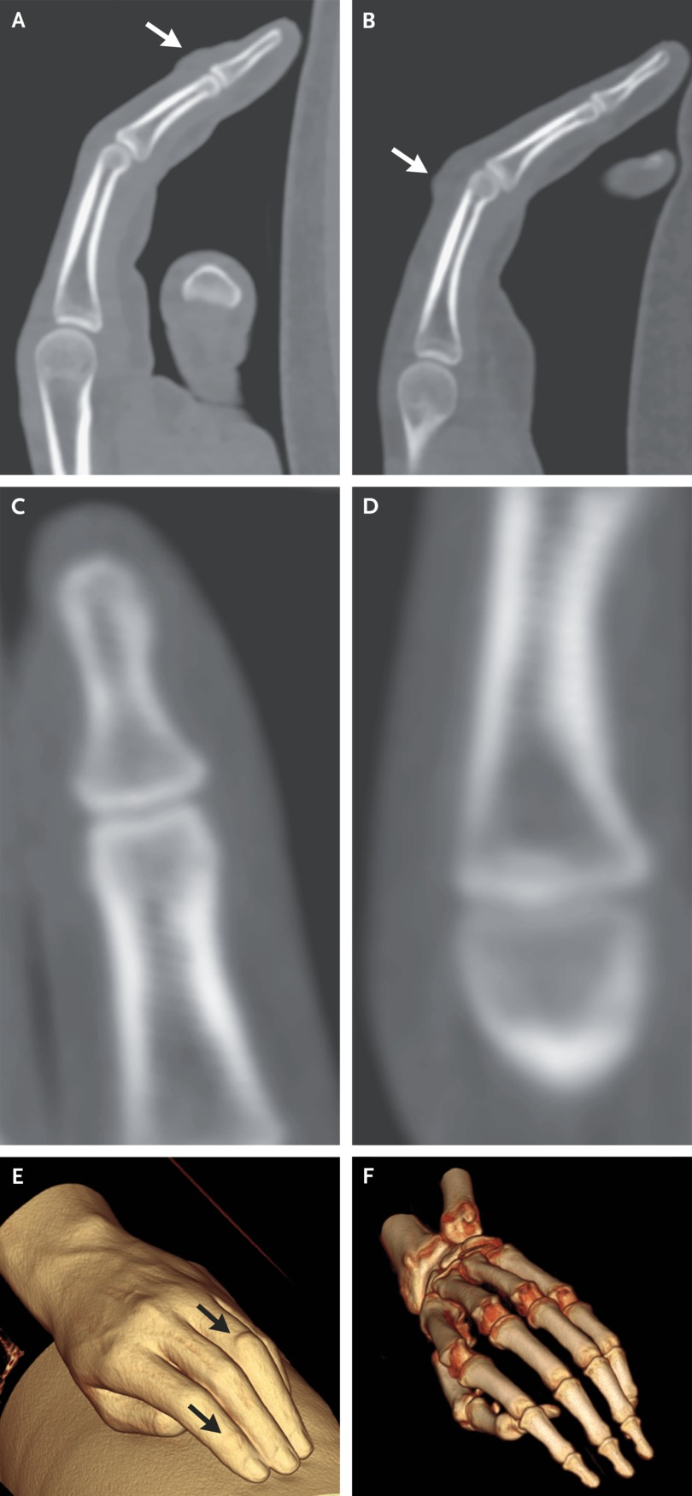
Imaging Studies.
Winston LG et al. N Engl J Med2021;385:2078-2086
Notes:
Figure 2 Imaging Studies. CT of the left hand was performed after the administration of intravenous contrast material. Sagittal images centered on the second digit and the fourth digit (Panels A and B, respectively) show focal soft-tissue swelling (arrows) overlying the second distal interphalangeal joint and the fourth proximal interphalangeal joint on the dorsal aspect of the hand. Coronal images centered on the second distal and fourth proximal interphalangeal joints (Panels C and D, respectively) show no evidence of osseous erosion, periosteal reaction, fracture, joint effusion, or fluid collection. A three-dimensional reconstruction of the left hand (Panel E) also shows focal soft-tissue swelling (arrows) overlying the second distal and fourth proximal interphalangeal joints. A three-dimensional image of the bones (Panel F) shows no abnormal features.

Slide 5
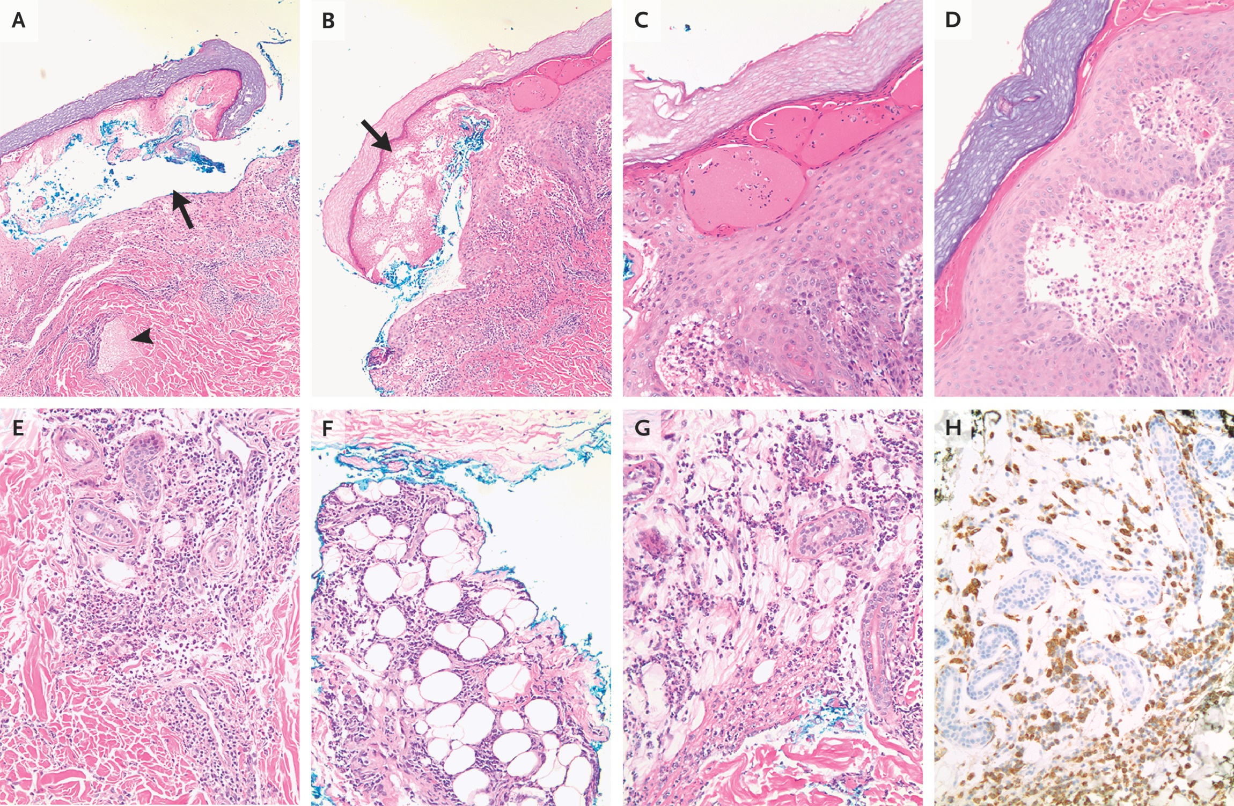
Microscopic Analysis of Skin Specimens.
Winston LG et al. N Engl J Med2021;385:2078-2086
Notes:
Figure 3 Microscopic Analysis of Skin Specimens. Hematoxylin and eosin staining of a punch-biopsy specimen of skin from the dorsal surface of the left fourth digit shows bullae formation (Panel A, arrow), lymphatic dilatation (Panel A, arrowhead), and epidermal necrosis (Panel B, arrow). At higher magnification, the epidermis shows intraepidermal microvesicles (Panel C) and underlying subepidermal edema with early bullae formation (Panel D). There is a dermal periadnexal and perivascular cellular infiltrate (Panel E) that extends into the adipose tissue of the hypodermis (Panel F). The infiltrate has focal areas of necrosis with associated dermal edema, and it is predominantly lymphohistiocytic, with occasional neutrophils (Panel G). Immunohistochemical staining shows abundant cells expressing CD68, a marker of histiocytic origin (Panel H, in brown).

Slide 6
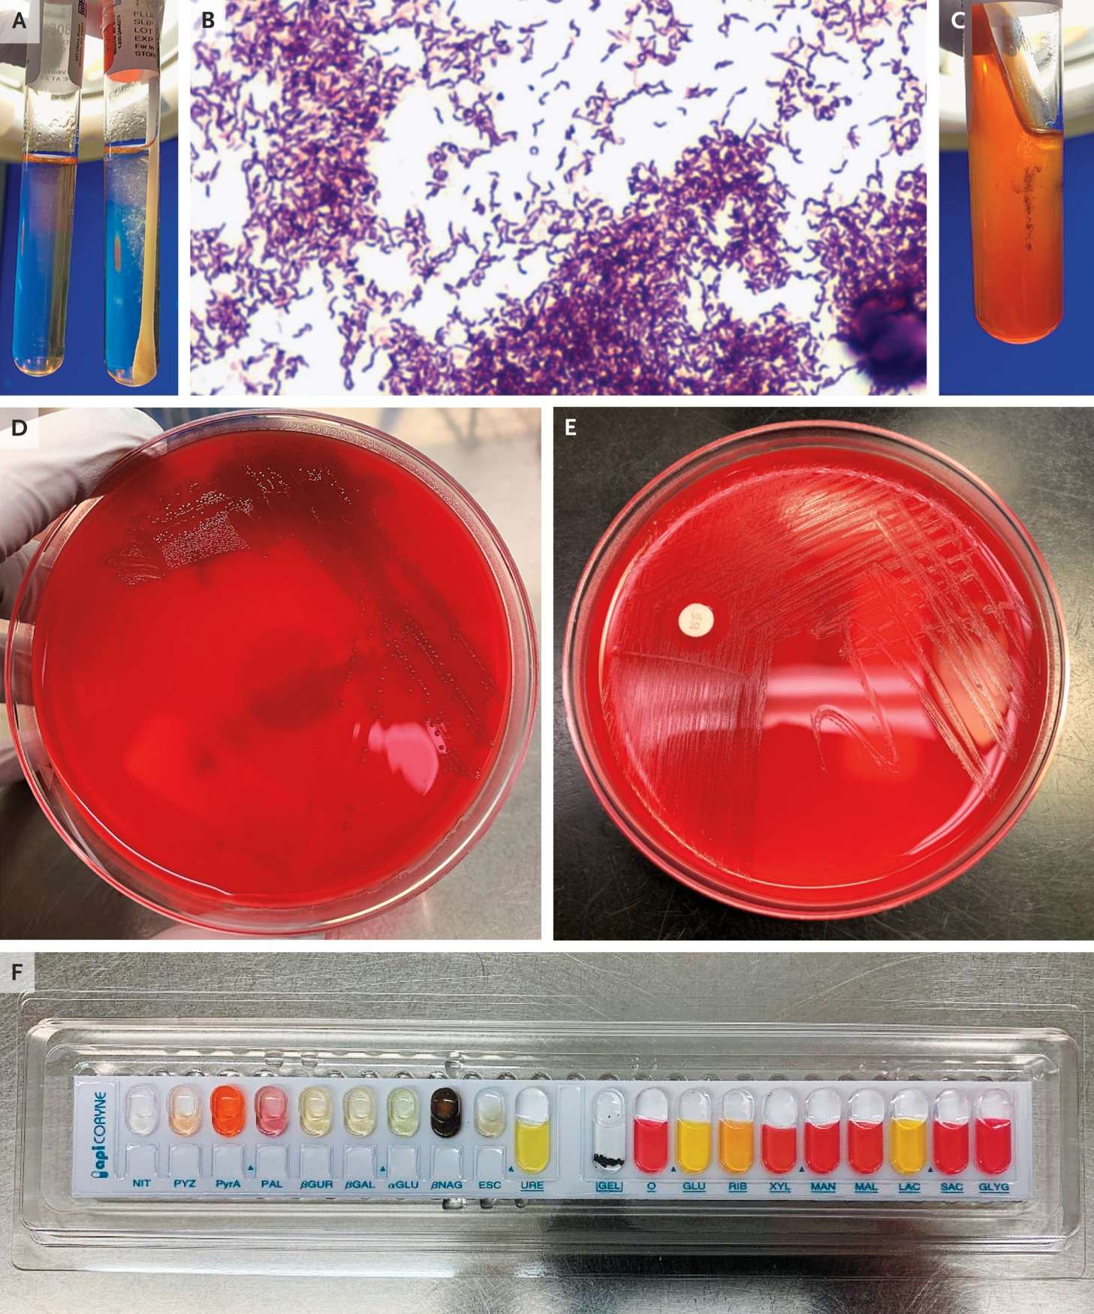
Microbiologic Culture of Skin Specimens.
Winston LG et al. N Engl J Med2021;385:2078-2086
Notes:
Figure 4 Microbiologic Culture of Skin Specimens. A superficial swab of a skin lesion was inoculated into thioglycolate broth and incubated in an atmosphere of 3 to 5% carbon dioxide at 35 to 37°C. Panel A shows bacterial growth on day 2 throughout the medium but primarily in the top and middle parts of the tube (right tube), a classic feature of facultative anaerobic bacteria. In Panel B, Gram’s staining of the colonies shows gram-positive, rod-shaped bacteria with nonsporulating, nonbranching, filamentous features. Panel C shows that the organism produced hydrogen sulfide after inoculation into a triple sugar iron agar slant tube. The production of hydrogen sulfide is indicated by the presence of ferrous sulfide (shown as a black precipitate), which is produced when ferrous ammonium sulfate (present in the triple sugar iron agar) reacts with hydrogen sulfide gas. Panel D shows that the organism developed small alpha-hemolytic colonies after subculture and overnight incubation on routine sheep-blood agar. Panel E shows bacterial colonies abutting a 30-μg vancomycin disk, a finding that indicates antimicrobial resistance. In Panel F, a biochemical test panel confirms that the pathogen is Erysipelothrix rhusiopathiae.

Slide 7
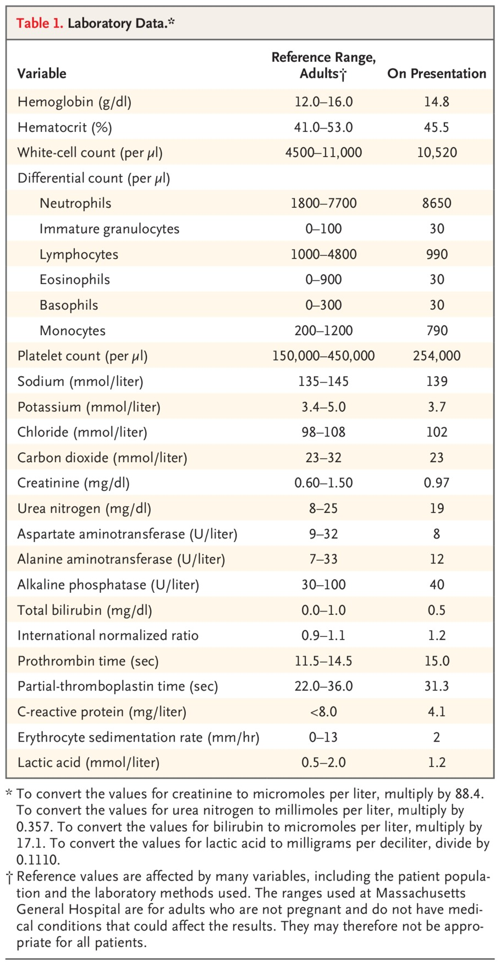
Laboratory Data.
Winston LG et al. N Engl J Med2021;385:2078-2086
Notes:
Table 1 Laboratory Data.

Slide 8
Final Diagnosis
Erysipelothrix rhusiopathiae infection.

